Slide 1
Nuclear Physics
REU CUA
Week 7
Richard Lara Ortiz

Slide 2
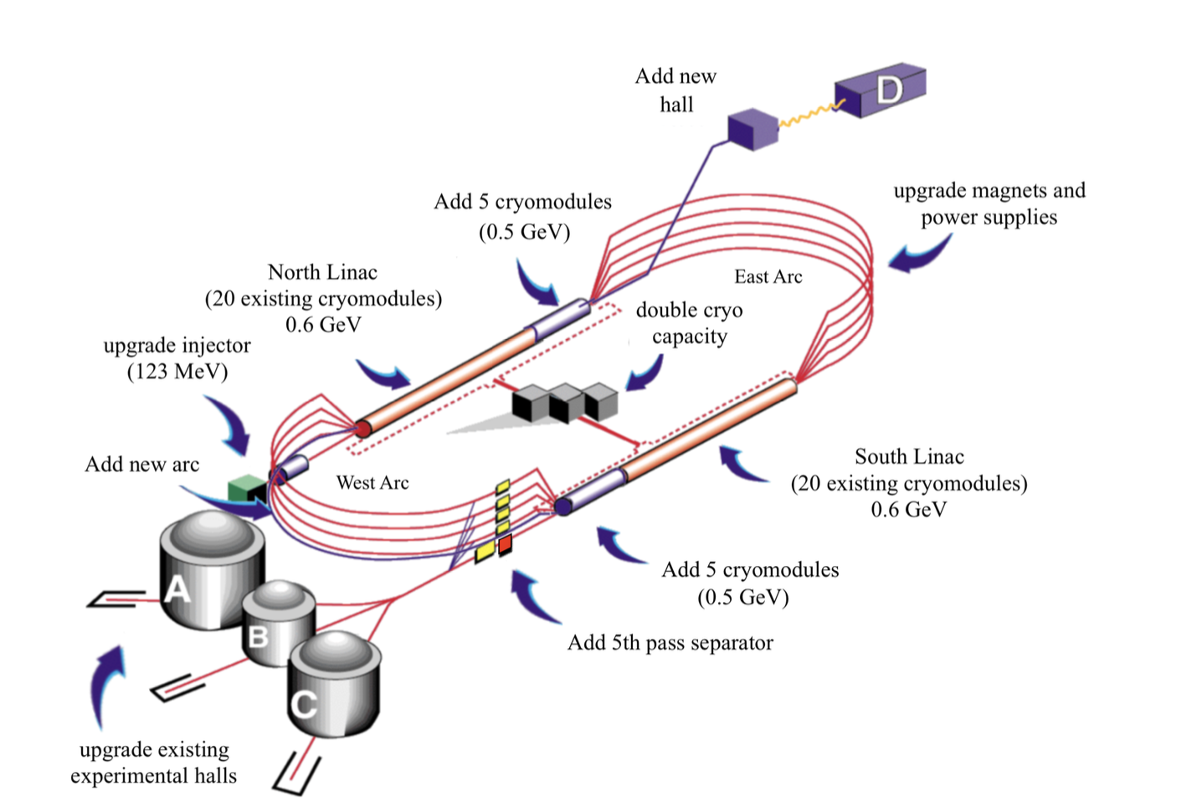
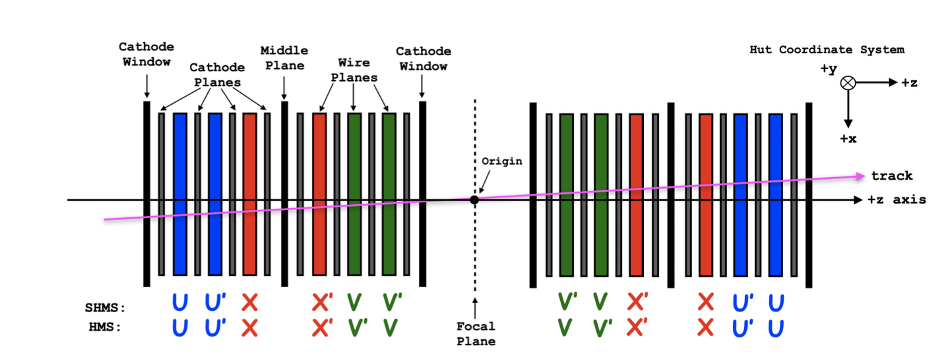
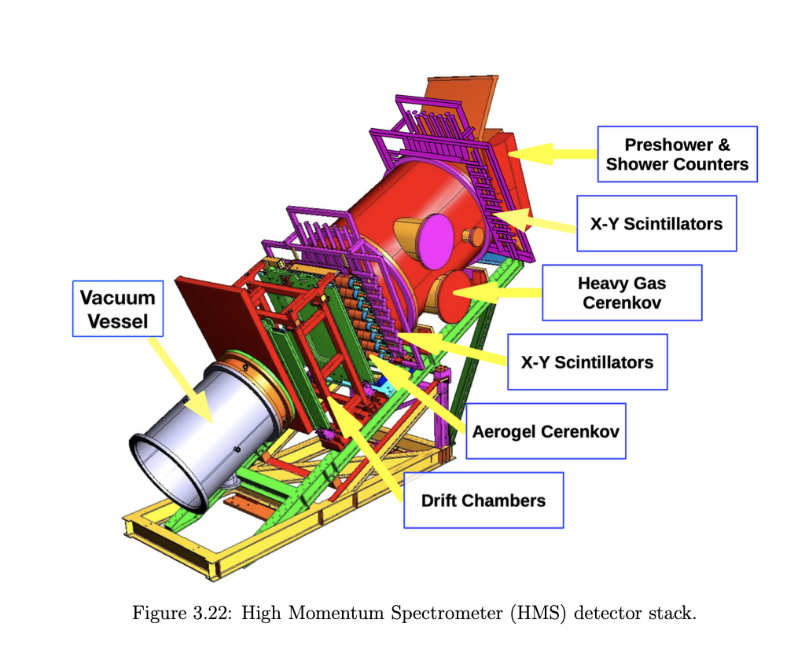
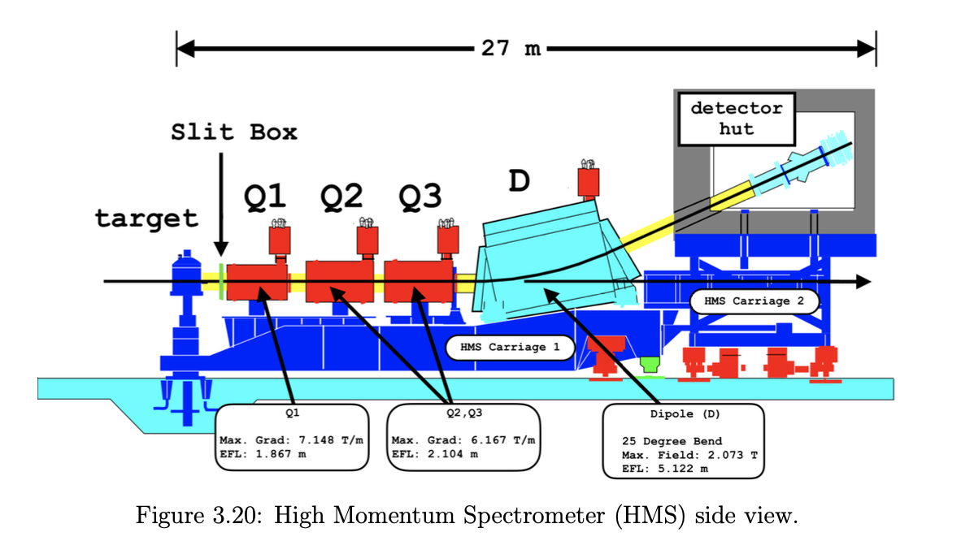
Calibration Checks of Drift Chambers for the Deuteron Electro-Disintegration Experiment
Deuteron Elastic Scattering Collisions
The Deuteron Experiment
Deuteron elastic collisions are the simplest types of collisions observed in Nuclear Physics experiments due to the relatively simple nucleon-nucleon interactions and are commonly used to research the fundamental forces present in the binding of the deuteron. However, a discrepancy between the theoretical and experimental data of the calculation of ²H(e,e’p)n missing momentum at momentum ranges greater than 700 MeV/c has been widely observed. Therefore, this experiment primarily focuses on unraveling this discrepancy through the kinematic reconstruction of the elastic scattering collision and particles present during the experiment.
These experiments are part of Dr. Yero’s work for Cross Section Measurements of Deuteron Electro-Disintegration at Very High Recoil Momentum and Large 4-Momentum Transfers (Q2), and are carried out in the experimental Hall C at the Thomas Jefferson National Accelerator Facility at their Continuous Electron Beam Accelerator Facility, which provides a race-track like path for the electron beam to accelerate and reach energies of up to 12 GeV/c. Within this race-track, there are four exits for the beam to deviate into, Hall A, B, C, and D.
My research is only concerned with the beam entering Hall C which is constrained to a system of optics (magnets) that focus the beam at the center of its cross-sectional area and hits a choice of target (liquid deuterium, hydrogen, etc). In the deuteron experiment, the energy beam hits a target of 10 centimeter-long liquid deuterium contained in a cylindrical vessel kept at a temperature of T_{LD2} = 22 +/- 0.1 k (~ -420 F/ -251.15 C), which results into disintegration of the deuteron and the scattering of the proton, neutron, and electron. The scattered electrons are detected by the Super High Momentum Spectrometer (SHMS) in coincidence with scattering proton detected in the High Momentum Spectrometer (HMS) and the recoiling neutrons are kinematically reconstructed from energy-momentum conservation laws. These spectrometers’ central angles and momentum are fixed accordingly to measure the central missing momentum at setting corresponding to 80, 580, 750, 800, and 900 MeV/c.
Drift Chambers
The High Momentum Spectrometer
Include a description of the drift chambers components.
Field wires
Sense wires
Cells and different planes
TDC and discriminator cards
Explain what is measured and how they are measured: tzero, wire hits, etc.
The HMS is equipped with a set of particle detectors: a pair of drift chambers used for track reconstruction, two pairs of hodoscope planes used for particle triggering, a calorimeter used for the e/pi separation, and a gas and aerogel Cherenkov used for addition particle identification. It is capable of detecting particles with a central momentum from 0.4 to 7.4 GeV/c and can be rotated from 10.5° to 85°.
The drift chambers are place first in the spectrometer because they provide high-precision tracking of charged particles with minimal interaction, efficiently detect particles over large areas, and play a crucial role in initial momentum measurement.
My project is to work on the calibration of the drift chamber pair in the HMS by using H(e,e’p) coincidence data taken from an experiment conducted in Hall C in March 2023 and check the accuracy of the calibration parameters by analyzing the simulated results obtained by using JLab’s Monte Carlo simulation compared to the experimental results.

Slide 3
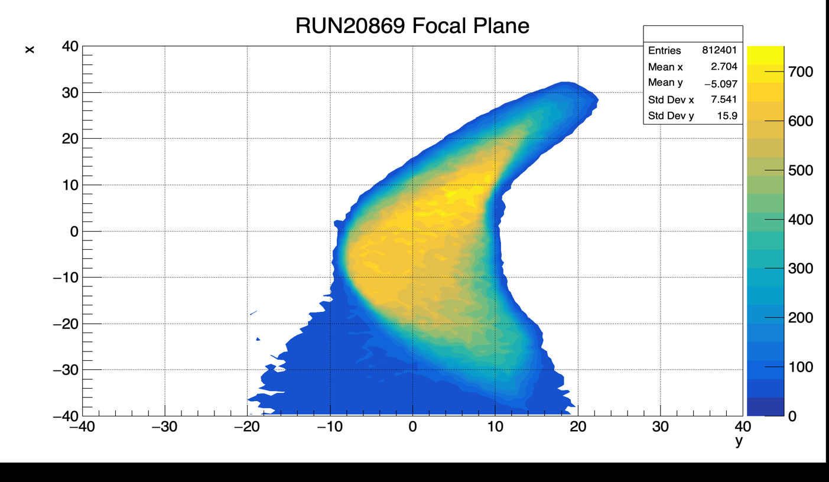
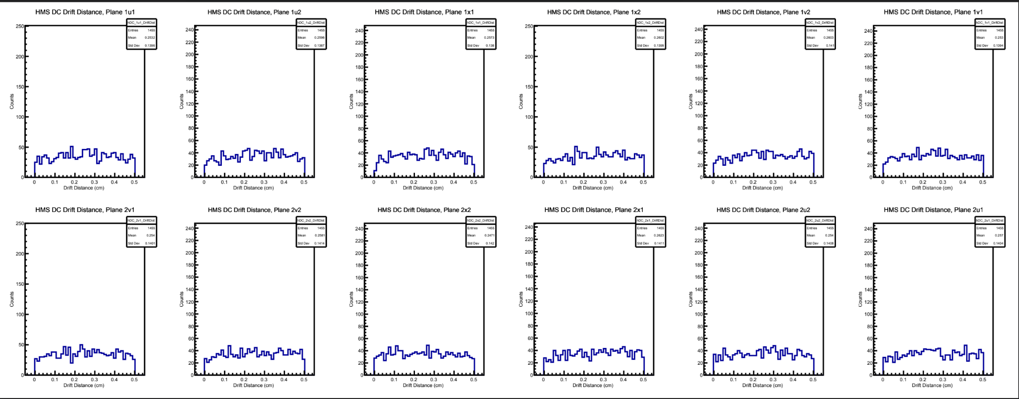
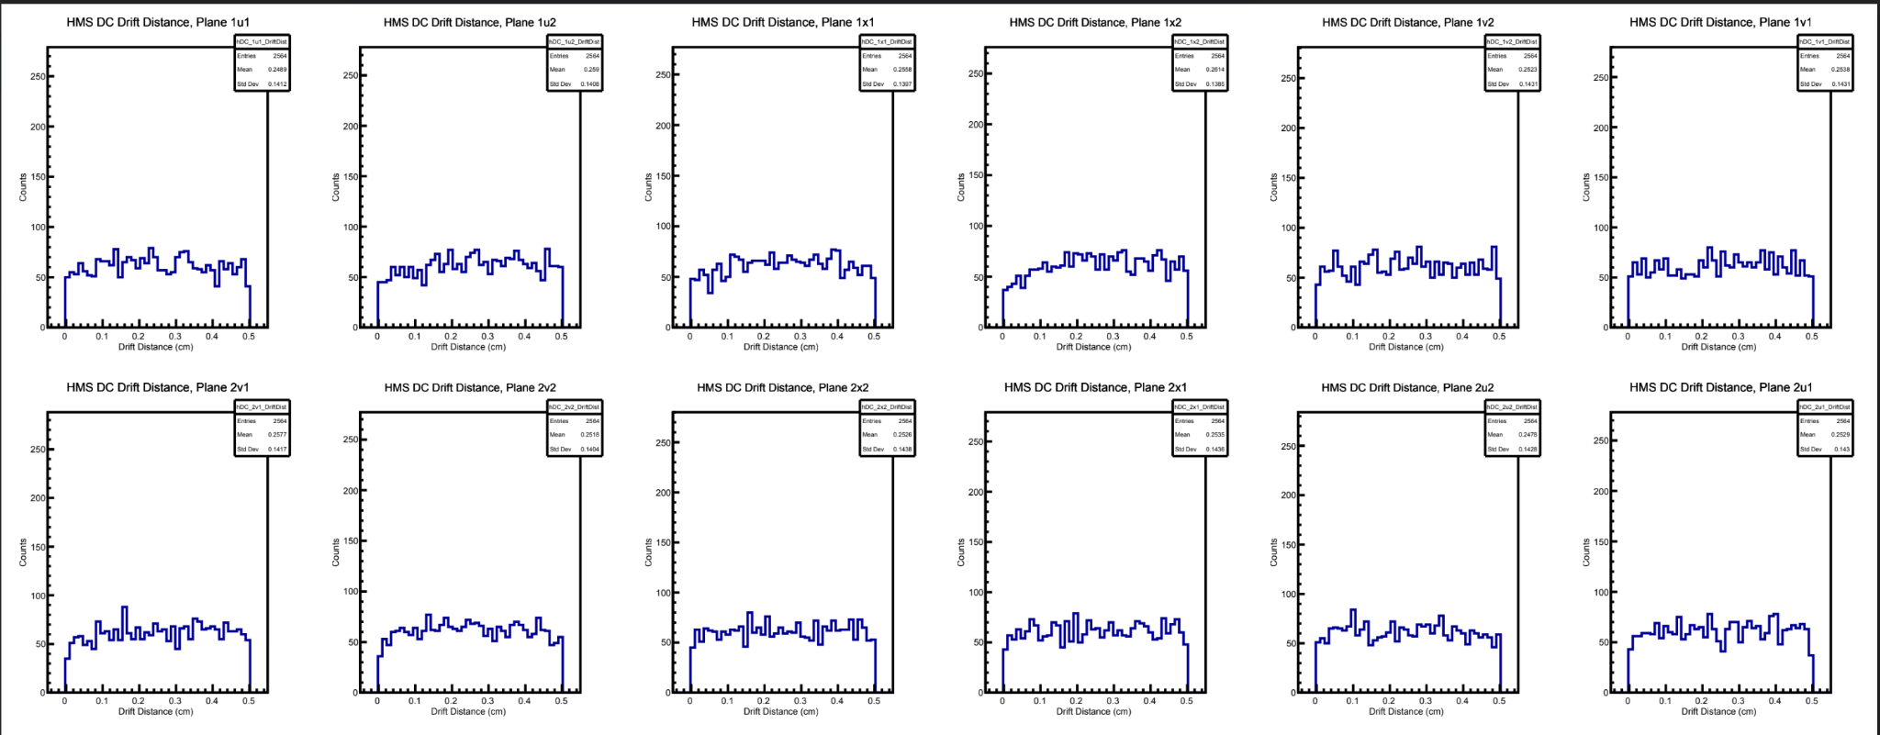
Phase 1: Calibration of HMS Drift Chambers
Analyzing H(e,e’p) Coincidence Uncalibrated Data
What values are being calibrated?
From the March 2023 experiment runs, eight coincidence H(e,e’p) raw data files were produced, each with different spectrometer momenta acceptance (𝞭) ranging from -12 to +16. These raw data files must be converted into a usable file; therefore, using the provided code, it replays over all the physics events recorded in the file and extracts all time, distance, wire hits, and all the parameters recorded by the detectors by their respective spectrometers. These variables are stored in ROOT file containing three different trees, each creating histograms of their respective (leaf) variables.
Include description of tzero corrections and histograms of before and after.
Include histograms of before and after drift distance distribution and drift distance planes.
Explain what other parameters are being calibrated
From the replayed ROOT file, the focal plane distribution was analyzed to check for any significant shifts. If no significant difference is present, then the data file with the most physics events will provide a sufficient coverage for the calibration process and such was the case.
Calibration Process
The initial replay of the file will produce a directory with files containing the following: uncalibrated/calibrated drift times, fitted drift times, fitted drift times, tzero_v_wire graphs, data files containing wire, tzero, tzero_error, and entries, a parameter file containing the time-to-distance look-up values, and a parameter file containing per-wire tzero corrections.
The produce parameter files are copied to the parameter file used by the same code that replayed the uncalibrated data. With these parameters copied over, the parameter for using tzero per wire is turned on to apply the corresponding corrections during the second replay.
Further explain what ./hcana SCRPITS/COIN/… does with the calibrated parameter files
Testing at Higher Missing Momentum
To check the calibration parameters, raw data files at higher momentum of p_{m}= 800 and 900 MeV/c were replayed using these parameters. The desired results are for the drift distance planes to be about uniformly distributed with no excess events or deficiency at any range. The first histograms correspond to 800 MeV/c and the second to 900 MeV/c.
At these momentum ranges, the number events drastically decrease. However, the drift distance planes all seem to be relatively uniformly distributed, therefore, indicating a good calibration of the HMS drift chambers.
How are the drift times converted to drift distances?
Further explain the details of tzero and drift times. Add the final equation that calculates the drift time distance-to-plane look up values.
Constraints for the drift distance planes: must be about uniformly distributed, no excess or deficient entries at either range
Include histograms

Slide 4
Phase 2: Testing accuracy of the calibration parameters
Obtaining Simulation Data
Comparison of Simulation and Experimental
Explain what the SIMC code and the process of checking the offsets in the standard.kinematics file and .data file have no discrepancies.
Include the the histograms of the overlapped simulated and experimental data such as the missing energy, q2, nu, angles, xbj, etc….
Explain the analysis of the histograms and what it physically means in comparison to the simulated data
Developing a Data Analysis Code
Using C++ and ROOT libraries, I developed code to perform the data analysis of the simulated data ROOT file. The code takes in the ROOT file, searches the tree for the variables of interest, creates properly normalized and weighted histograms of each variable, and write these histograms to an Output file named “name_of_file_analyzed.root”.
This slide will include descriptions of the work hopefully finish by next week.

Slide 5
This Week’s Progress
Develop a code that takes the SIMC ROOT file as an input to extract the leaf variables of interest and produces properly normalized weighted histograms stored in an output ROOT file.
Show the code and histograms.

